Slide 1
E6156 – Topics in SW Engineering: Cloud Computing
Lecture 7: CloudFront, NoSQL, Certificates, DNS, Service Composition
© Donald F. Ferguson, 2021

Slide 2

Will will start in a minute.
2 | E6156 – Topics in SW Engineering: Lecture 7: CloudFront, NoSQL, Certificates, DNS, Service Composition © Donald F. Ferguson, 2021

Slide 3
Come Code Walkthroughs Smarty – Samples (Python, UI) Notification
Lambda Functions ← SNS
3 | E6156 – Topics in SW Engineering: Lecture 7: CloudFront, NoSQL, Certificates, DNS, Service Composition © Donald F. Ferguson, 2021

Slide 4
NoSQL DynamoDB
4 | E6156 – Topics in SW Engineering: Lecture 7: CloudFront, NoSQL, Certificates, DNS, Service Composition © Donald F. Ferguson, 2021

Slide 5
Core Transaction Concept is ACID Properties
http://slideplayer.com/slide/9307681
ACID
Atomic
“ALL OR NOTHING”
Transaction cannot be subdivided
Consistent
Transaction → transforms database from one consistent state to another consistent state
Isolated
Transactions execute independently of one another
Database changes not revealed to users until after transaction has completed
Durable
Database changes are permanent
The permanence of the database’s consistent state

Slide 6
ACID Properties (httpwww.tutorialspoint.com/dbms/dbms_transaction.htm)
A transaction is a very small unit of a program and it may contain several low-level tasks. A transaction in a database system must maintain Atomicity, Consistency, Isolation, and Durability − commonly known as ACID properties − in order to ensure accuracy, completeness, and data integrity.
Atomicity − This property states that a transaction must be treated as an atomic unit, that is, either all of its operations are executed or none. There must be no state in a database where a transaction is left partially completed. States should be defined either before the execution of the transaction or after the execution/abortion/failure of the transaction.
Consistency − The database must remain in a consistent state after any transaction. No transaction should have any adverse effect on the data residing in the database. If the database was in a consistent state before the execution of a transaction, it must remain consistent after the execution of the transaction as well.
Durability − The database should be durable enough to hold all its latest updates even if the system fails or restarts. If a transaction updates a chunk of data in a database and commits, then the database will hold the modified data. If a transaction commits but the system fails before the data could be written on to the disk, then that data will be updated once the system springs back into action.
Isolation − In a database system where more than one transaction are being executed simultaneously and in parallel, the property of isolation states that all the transactions will be carried out and executed as if it is the only transaction in the system. No transaction will affect the existence of any other transaction.

Slide 7
Serializability
“In concurrency control of databases, transaction processing (transaction management), and various transactional applications (e.g., transactional memory^{[3]} and software transactional memory), both centralized and distributed, a transaction schedule is serializable if its outcome (e.g., the resulting database state) is equal to the outcome of its transactions executed serially, i.e. without overlapping in time. Transactions are normally executed concurrently (they overlap), since this is the most efficient way. Serializability is the major correctness criterion for concurrent transactions' executions. It is considered the highest level of isolation between transactions, and plays an essential role in concurrency control. As such it is supported in all general purpose database systems.” (https://en.wikipedia.org/wiki/Serializability)

Slide 8
CAP Theorem
Consistency
Every read receives the most recent write or an error.
Availability
Every request receives a (non-error) response – without guarantee that it contains the most recent write.
Partition Tolerance
The system continues to operate despite an arbitrary number of messages being dropped (or delayed) by the network between nodes

Slide 9
Consistency Models
STRONG CONSISTENCY: Strong consistency is a consistency model where all subsequent accesses to a distributed system will always return the updated value after the update.
WEAK CONSISTENCY: It is a consistency model used in distributed computing where subsequent accesses might not always be returning the updated value. There might be inconsistent responses.
EVENTUAL CONSISTENCY: Eventual consistency is a special type of weak consistency method which informally guarantees that, if no new updates are made to a given data item, eventually all accesses to that item will return the last updated value.

Slide 10
BASE
Eventually-consistent services are often classified as providing BASE (Basically Available, Soft state, Eventual consistency) semantics, in contrast to traditional ACID (Atomicity, Consistency, Isolation, Durability) guarantees. Rough definitions of each term in BASE:
Basically Available: basic reading and writing operations are available as much as possible (using all nodes of a database cluster), but without any kind of consistency guarantees (the write may not persist after conflicts are reconciled, the read may not get the latest write)
Soft state: without consistency guarantees, after some amount of time, we only have some probability of knowing the state, since it may not yet have converged
Eventually consistent: If the system is functioning and we wait long enough after any given set of inputs, we will eventually be able to know what the state of the database is, and so any further reads will be consistent with our expectations

Slide 11
Eventual Consistency
Availability and scalability via
Multiple, replicated data stores.
Read goes to “any” replica.
PUT/POST/DELETE
Goes to any replica
Change propagate asynchronously
GET may not see the latest value if the update has not propagated to the replica.
There are several algorithms for conflict resolution
Detect and handle in application.
Clock/change vectors/version numbers
… …
get
put

Slide 12
ACID – BASE (Simplistic Comparison)
(Or other strategy)

Slide 13
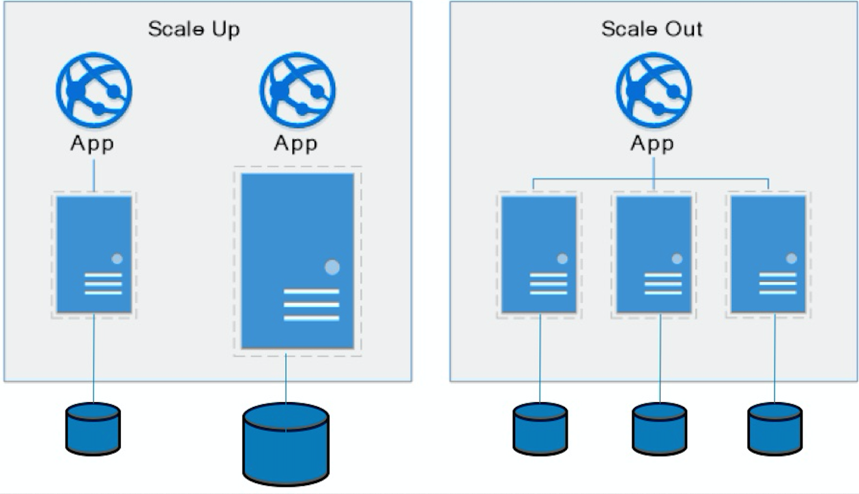
Approaches to Scalability
Scalability is the property of a system to handle a growing amount of work by adding resources to the system.
Replace system with a bigger machine, e.g. more memory, CPU, ... ...
Scale-up:
Less incremental.
More disruptive.
More expensive for extremely large systems.
Does not improve availability
Scale-out:
Incremental cost.
Data replication enables availability.
Does not work well for functions like JOIN, referential integrity, ... ...
Add another system.

Slide 14
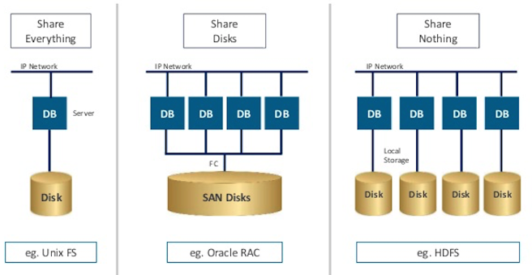
Disk Architecture for Scale-Out
Share disks:
Is basically scale-up for data/disks. You can use NAS, SAN and RAID.
Isolation/Integrity requires distributed locking to control access from multiple database servers.
Share nothing:
Is basically scale-out for disks.
Data is partitioned into shards based on a function f() applied to a key.
Can improve availability, at the code consistency, with data replication.
There is a router that sends requests to the proper shard based on the function.

Slide 15
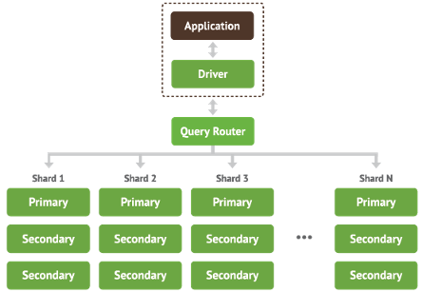
Shared Nothing, Scale-Out
MongoDB Sharding
DynamoDB Partitioning

Slide 16
DynamoDB
16 | E6156 – Topics in SW Engineering: Lecture 7: CloudFront, NoSQL, Certificates, DNS, Service Composition © Donald F. Ferguson, 2021

Slide 17
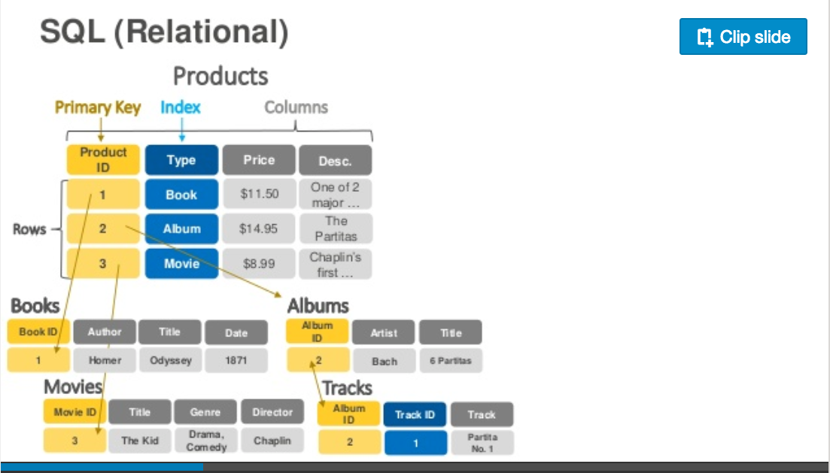
DynamoDB – Relational
https://www.slideshare.net/AmazonWebServices/introduction-to-amazon-dynamodb-73191648

Slide 18
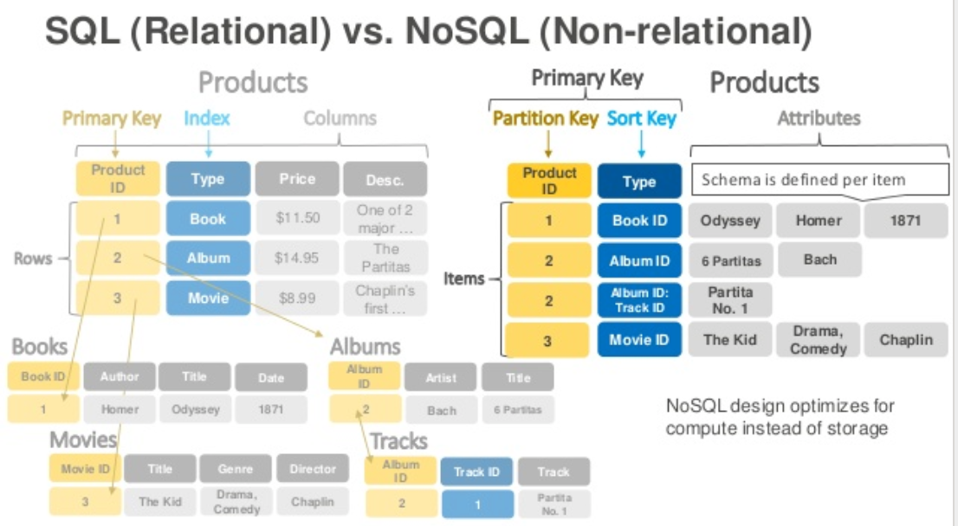
DynamoDB Data Model
Dynamo DB – Relational

Slide 19
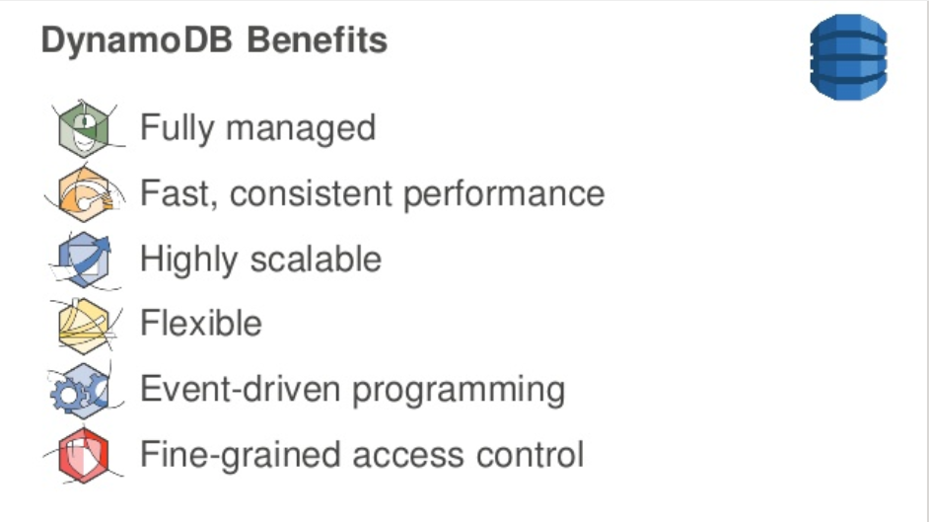
DynamoDB
DynamoDB Benefits

Slide 20
DynamoDB Hashing
DynamoDB – Hash Key

Slide 21
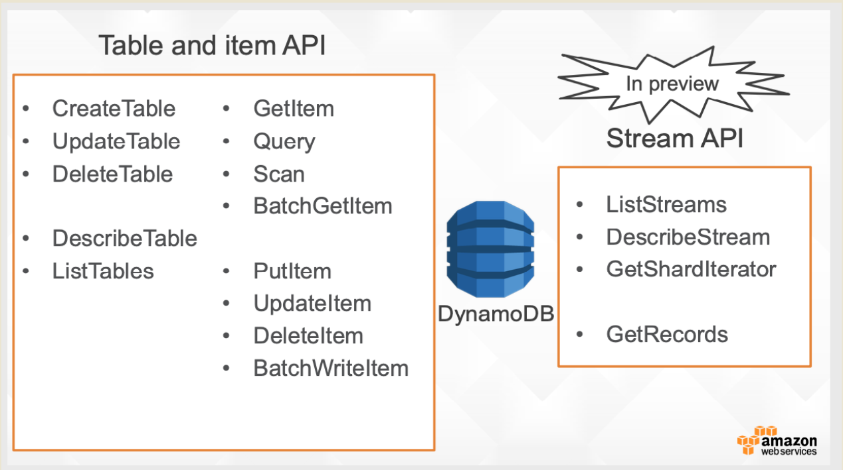
DynamoDB Model
21 | E6156: Topics in SW Engineering – Cloud Computing/BaaS

Slide 22
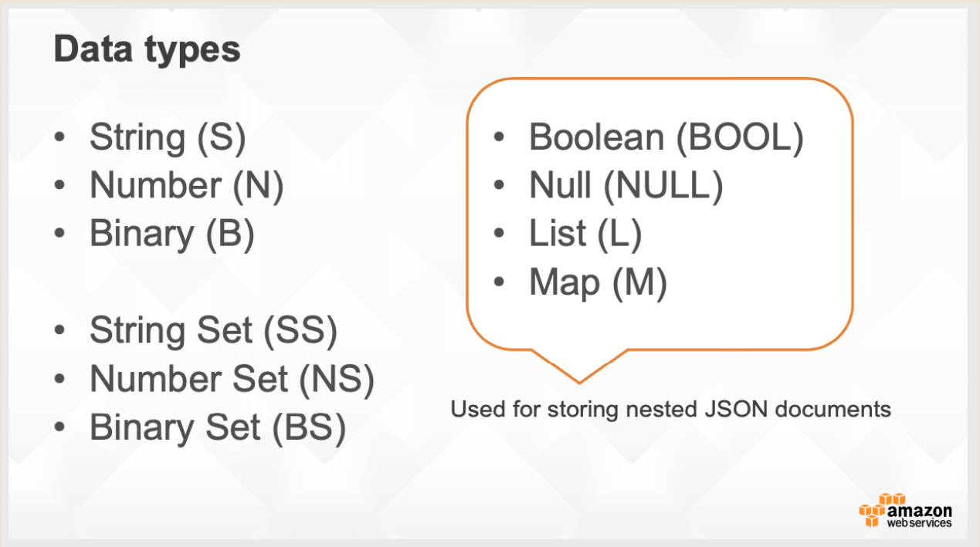
DynamoDB Model
22 | E6156: Topics in SW Engineering – Cloud Computing/BaaS

Slide 23
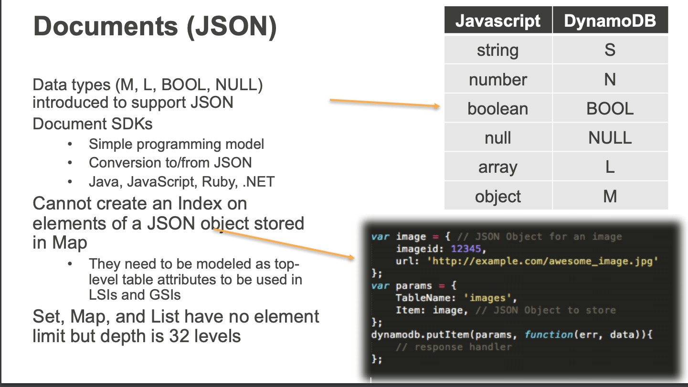
DynamoDB Model
23 | E6156: Topics in SW Engineering – Cloud Computing/BaaS

Slide 24
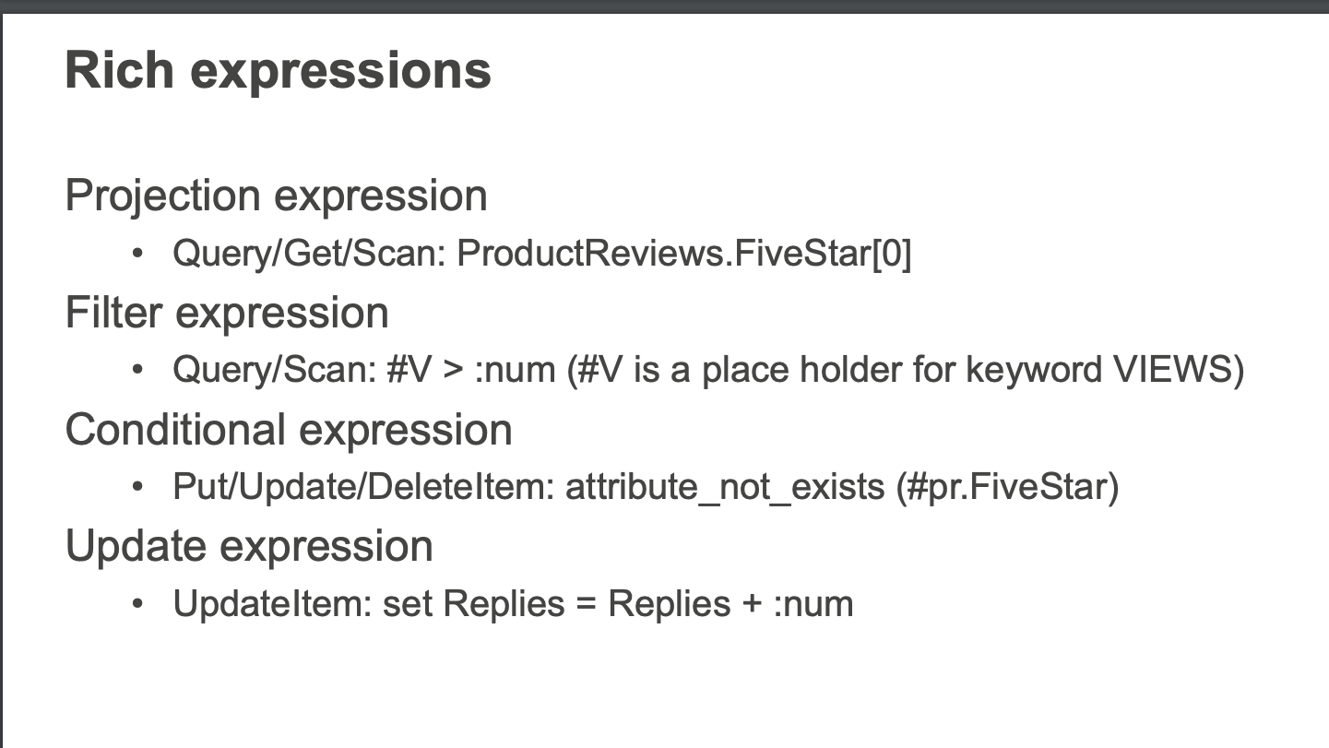
DynamoDB Model
24 | E6156: Topics in SW Engineering – Cloud Computing/BaaS

Slide 25
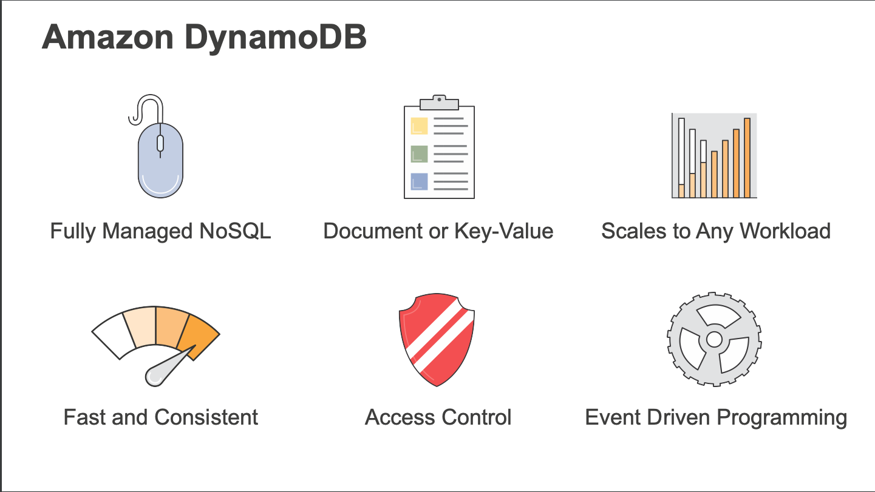
DynamoDB
25 | E6156 – Cloud Computing: Backend-as-a-Service (Lecture 6)

Slide 26
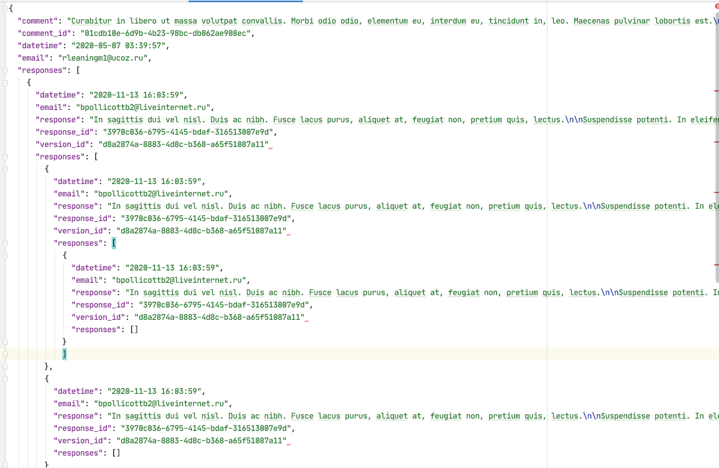
Document Databases – Semi-Structured Schema
The relation model has difficulties with some types of data:
Columns that are lists or maps
Nesting – things inside things
Discover you need a modified schema when you get a piece of data.
etc.
All of these are common for documented like data:
Threaded discussions.
Documents.
... ...
Document DBs emerged to handle these scenarios.
26 | E6156: Topics in SW Engineering – Cloud Computing/BaaS

Slide 27
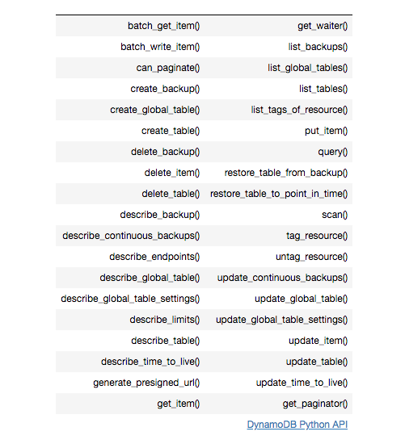
DynamoDB Summary
Achieves much greater scalability and performance than RDBMs
Does not support some RDBMs capabilities:
Referential integrity.
JOIN
Queries limited to key fields.
Non-key field queries are always scans.
Data model better fit for semi-structured data models and good fit for JSON
Maps
Lists

Slide 28
ETag, Conditional Update
28 | E6156 – Topics in SW Engineering: Lecture 7: CloudFront, NoSQL, Certificates, DNS, Service Composition © Donald F. Ferguson, 2021

Slide 29
REST and Isolation: Read then Update Conflict
Some
Resource
1. Bob GETs the resource.
3. Bob changes the data based on values.
2. Mary GETs the resource.
If
The written value
Depends on the read value.
The resource may be in the wrong state at the end.
The execution was RRWW
But the intent was RWRW.
4. Mary changes the data based on values.

Slide 30
Isolation/Concurrency Control
This requires conversation state, which would violate the REST Stateless principle.
There are two basic approaches to implementing isolation
Locking/Pessimistic, e.g. cursor isolation
Optimistic: Before committing, each transaction verifies that no other transaction has modified the data it has read.
How does this work in REST?
The server maintains an ETag (Entity Tag) for each resource.
Every time a resource’s state changes, the server computes a new ETag.
The server includes the ETag in the header when returning data to the client.
The server may optionally maintain and return “Last Modified” time for resources.
Semantics on updates
If-Match – value of a previous calls ETag response used with a PUT or DELETE. Server should only act if nobody else has modified the resource since you last fetched it. Otherwise provides a 412.
If-Modified-Since – value of a previous Last-Modified response used with a GET. Server should only provide a response if the resource was modified since the timestamp submitted. Use in conjunction with If-None-Match in case the change occurred within the same second. Otherwise provide a 304.
If-None-Match – value of a previous calls ETag response used with a GET. Server should only provide a response if the ETag doesn’t match, i.e. the resource has been altered. Otherwise provide a 304.
If-Unmodified-Since – value of a previous Last-Modified response used with a PUT or DELETE. Server should only act if nobody else has modified the resource since you last fetched it. Otherwise provides a 412

Slide 31
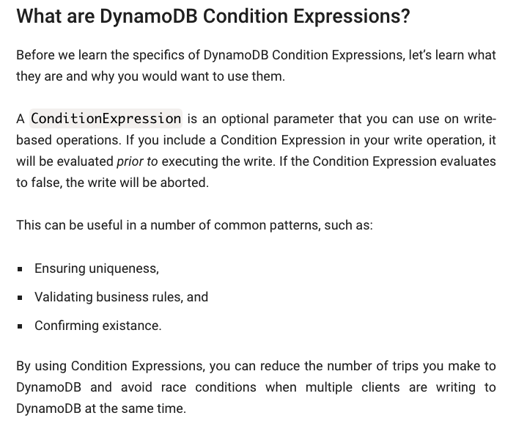
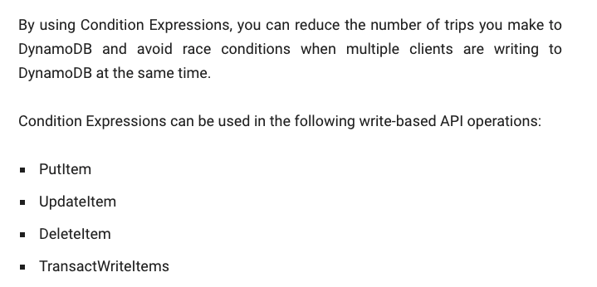
Conditional Operations

Slide 32
Hands-On CloudFront DNS, Certificate, HTTPS
32 | E6156 – Topics in SW Engineering: Lecture 7: CloudFront, NoSQL, Certificates, DNS, Service Composition © Donald F. Ferguson, 2021

Slide 33
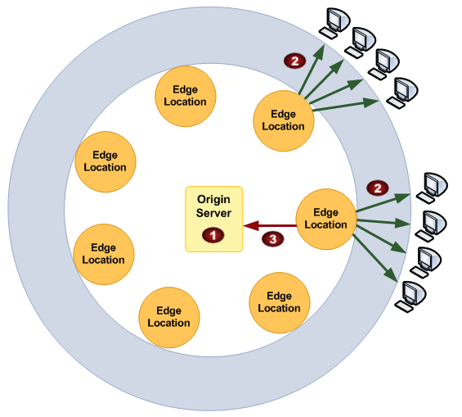
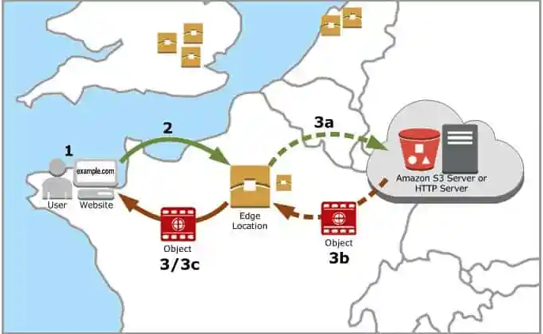
CloudFront
“A content delivery network, or content distribution network (CDN), is a geographically distributed network of proxy servers and their data centers. The goal is to provide high availability and performance by distributing the service spatially relative to end users.” (https://en.wikipedia.org/wiki/Content_delivery_network)

Slide 34
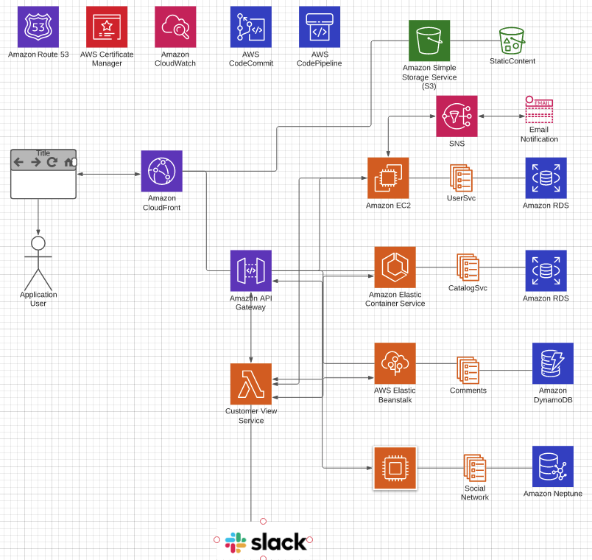
Overall Architecture
There may be multiple
Microservices
Web UI projects/content
FrontPage
Multiple S3 content → one site.
Forward API requests to API GW
API GW manages/monitors APIs
Networking/HTTPS requires
Domain, DNS
Certificates

